Slide 1
LoanBuddy: Loan Approval Prediction
Prastuti Acharya
23056304

Slide 2
Table of contents
01
02
03
04
Topic
Brief introduction of the topic and concepts used
Solution
Working mechanism and solution developed
Synthesis of Information
Analysis through algorithmic representation
Conclusion
Summary of the model

Slide 3
Introduction
LoanBuddy works by taking the user’s financial and personal details, processing it through a trained and tested model and predicting the result. The AI concepts used in developing this model are:
Logistic Regression
Decision Tree Classifier
Random Forest Classifier
Used for binary classification problems.
It classifies the outcomes into categories.
Classifies the data into branches based on a decision to make predictions.
An ensemble learning algorithm which combines multiple decision trees to predict using voting system.

Slide 4
Research
Intelligent Loan Assistant using Machine Learning and Data Science
TRUSTNOVA: A Predictive Machine Learning Model for Loan Approval
With the use of algorithms like logistic regression, decision tree classifier and random forest classifier, AI model for loan prediction with 89% accuracy was developed.
Using logistic regression, random forest classifier and Support Vector Machine(SVM) algorithms, model accuracy was found to be an average of 84.5%.

Slide 5

Why LoanBuddy?
Reduces manual paperwork in loan processing.
Automates and speeds up decision making.
Improves accuracy and consistency.
Demonstrates practical use of AI classification.

Slide 6
Solution
The model uses supervised learning where it learns from labelled data whose predictions are known. It uses binary classification to classify the results into two possible outcomes, “approved” and “denied”.
Data Understanding
Data Preparation
Understanding the dataset and the attributes.
Cleaning, scaling and balancing the dataset.
Train & Test
Analysis
Training and Testing of the model using the dataset.
Analysing the models through the evaluation metrics.

Slide 7

How does it solve problems?
Eliminates delays caused by manual processing.
Reduces errors and bias in loan approval.
Enhances efficiency in banking operations.
Enables scalable and data-driven decisions.

Slide 8
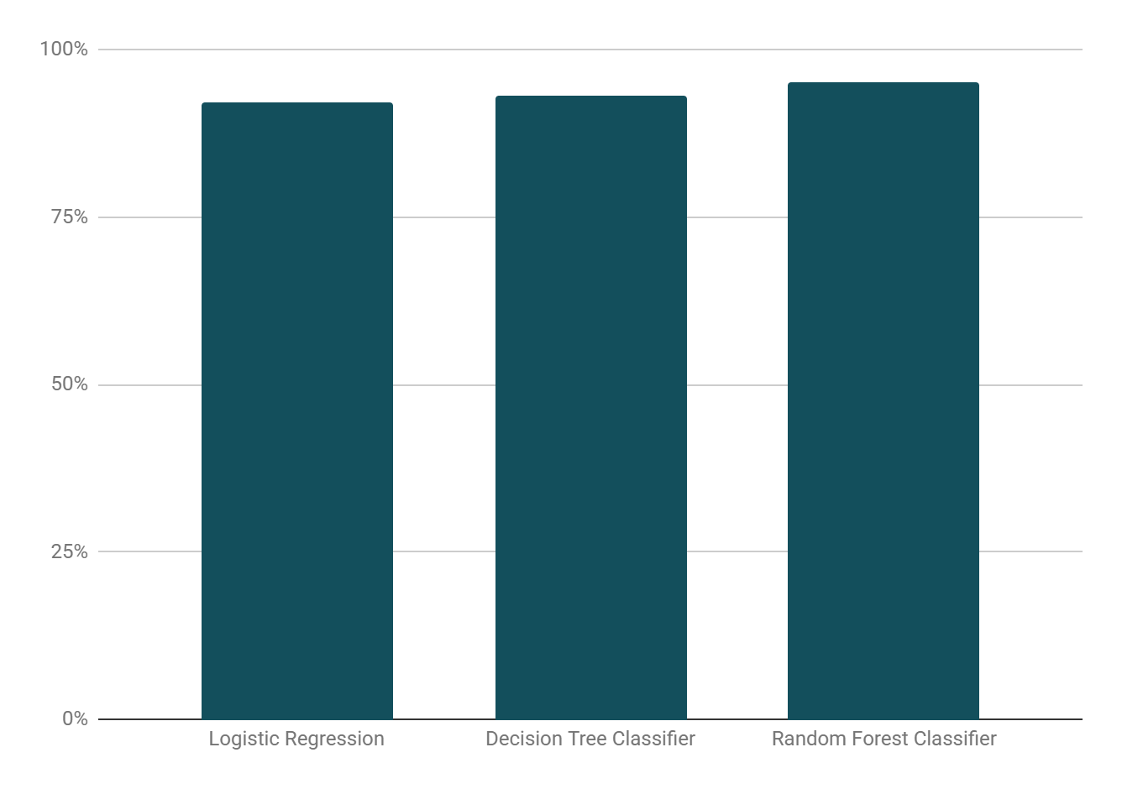
Evaluation of the Models
Accuracy
Logistic Regression: 92.89%
Decision Tree Classifier: 93.28%
Random Forest Classifier: 95.13%

Slide 9
Pseudocode of Logistic Regression
BEGIN
Load dataset
//Data Preparation Handling missing values
Encoding categorical features
Normalizing numerical features
//Training and Testing Separating dataset
into training and testing sets
Select classification model “Logistic
Regression”
Train classification model using training
set
//Evaluation and Prediction
Evaluate model performance on testing set
FUNCTION Predict (input features):
final_features = processed (input
features)
prediction_prob =
classification_model.Predict
(final_features)
IF prediction_prob >= 0.5 then
RETURN "Approved"
ELSE
RETURN "Rejected“
FUNCTION END
END

Slide 10
Pseudocode of Decision Tree
BEGIN
Load dataset
//Data Preparation Handling missing values
Encoding categorical features
Normalizing numerical features
//Training and Testing Separating dataset
into training and testing sets
Select regression model “Decision Tree
Classifier”
Train classification model using training
set
//Evaluation and Prediction
Evaluate model performance on testing set
FUNCTION Predict (input features):
final_features = processed (input
features)
prediction_prob =
classification_model.Predict
(final_features)
IF prediction_prob == 1 then
RETURN "Approved"
ELSE
RETURN "Rejected"
FUNCTION END
END

Slide 11
Pseudocode of Random Forest
BEGIN
Load dataset
//Data Preparation Handling missing values
Encoding categorical features
Normalizing numerical features
//Training and Testing Separating dataset
into training and testing sets
Select regression model “Random
Forest Classifier”
Train classification model using training
set
//Evaluation and Prediction
Evaluate model performance on testing set
FUNCTION Predict (input features):
final_features = processed (input
features)
prediction_prob =
classification_model.Predict
(final_features)
IF prediction_prob == 1 then
RETURN "Approved"
ELSE
RETURN "Rejected"
FUNCTION END
END

Slide 12
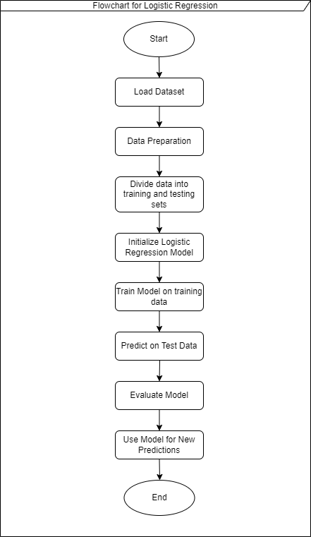
Flowchart of
Logistic Regression

Slide 13
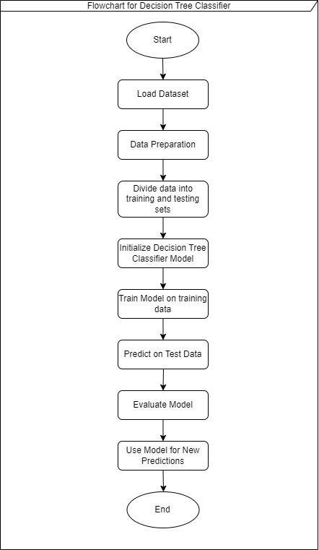
Flowchart of
Decision Tree Classifier

Slide 14
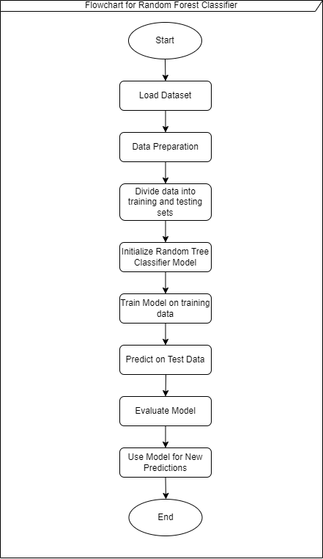
Flowchart of
Random Forest Classifier

Slide 15
Conclusion
The loan approval prediction AI model demonstrates how machine learning can solve real-world banking problems. It reduces manual paperwork, speeds up decisions, and ensures consistent, unbiased results. Models like Logistic Regression, Decision Tree, and Random Forest effectively classify loan applications.
Overall, this approach improves efficiency and reliability in financial decision-making.

Slide 16

Thank You.

